Slide 1


COMP3900 - Group Project
Developers:
Tara Brown
Jheanell McPherson
Andrew Stoddart
Vaun- Pierre Wynter

Slide 2
What to expect
Problem, Our Approach & Accomplishments
Application Design, Architecture & Challenges
Results!!!

Slide 3
What’s the Problem?
Difficulty in sourcing academic books for school.
Books are usually extremely expensive/ unavailable.
Difficulty in finding convenient living spaces in and around Mona
Notice boards on campus are cluttered making it hard to find what is needed

Slide 4
Our Approach
Finding an effective medium to advertise and sell textbooks and off- campus housing.
Implementing an online- based auctioning and shopping platform.
Features Bidding System & Recommender System

Slide 5
What we have accomplished!!
Interactive User Interface
Functioning Database
Reliable User Authentication
Successful Uploads to Database via Website
Bidding System (English Auction method)

Slide 6
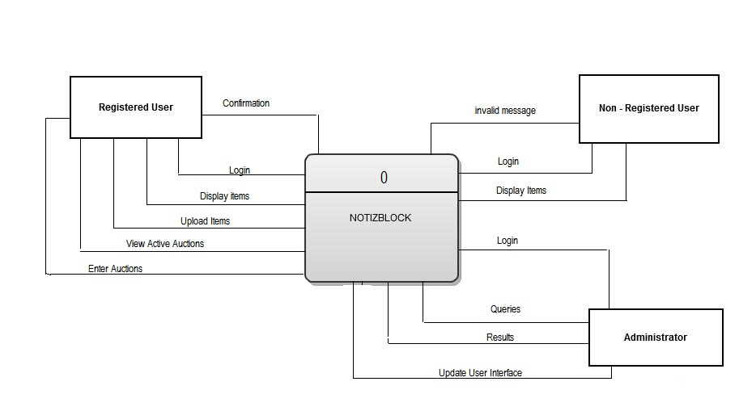
Application Design
Written in PHP – Modularly & Developed Incrementally
Web pages written in HTML & CSS
Database constructed using MYSQL
Designed for 3 types of user:
Administrator
Registered User
Non-Registered User
Notizblock.com – Context_diagram

Slide 7
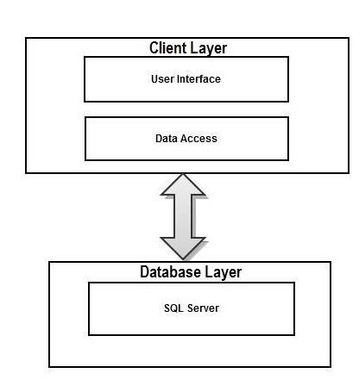
Application Architecture
2- Tier Client –Server Model
Client side interacts with application UI
Server side performs all application processing and Database management

Slide 8
Application Architecture: Database Structure
Core of application consists of a database built around 7 tables
basicUser
Item
Uploads
Bidson
Buy
House
book

Slide 9
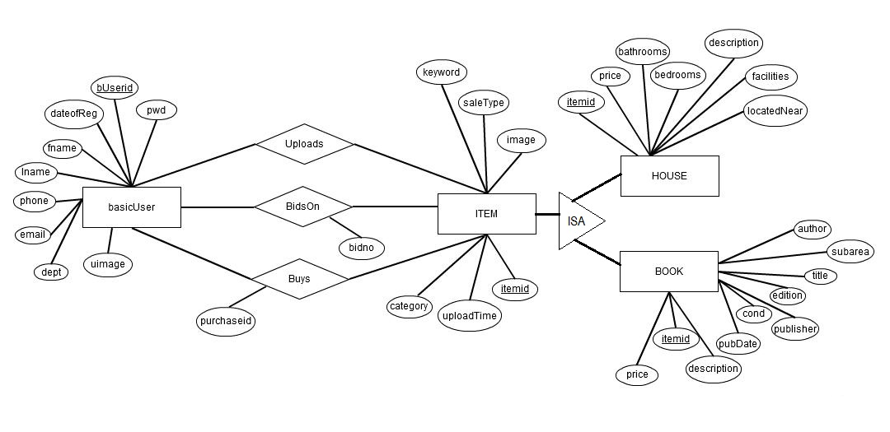
Application Architecture: Database Structure

Slide 10
Challenges
Simultaneous bidders on one item
Recommender Algorithm
- Collaborative- filtering approach
Database Security
- protection from administrative privileges

Slide 11
Results

